Slide 1




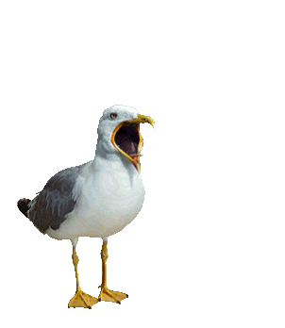
Wonderful life

Slide 2



Slide 3




Slide 4

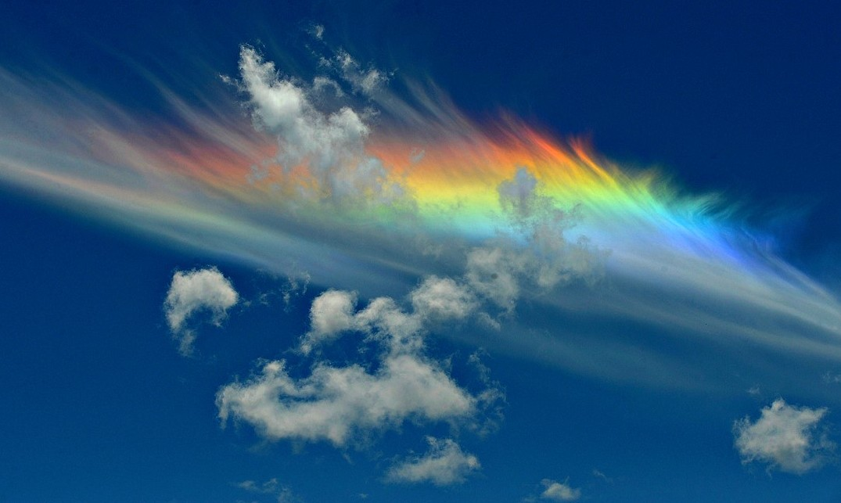

Slide 5




Slide 6



Slide 7
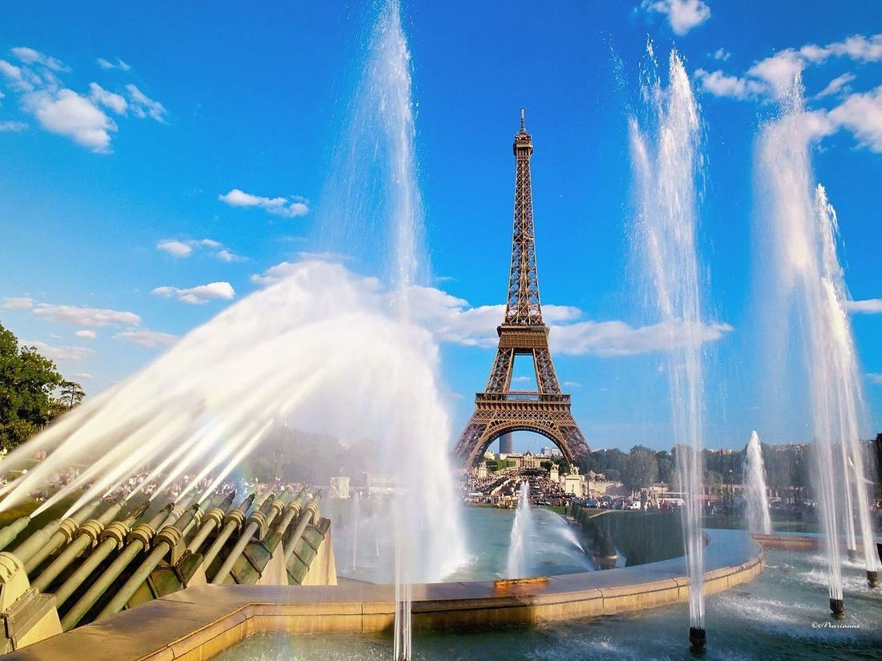
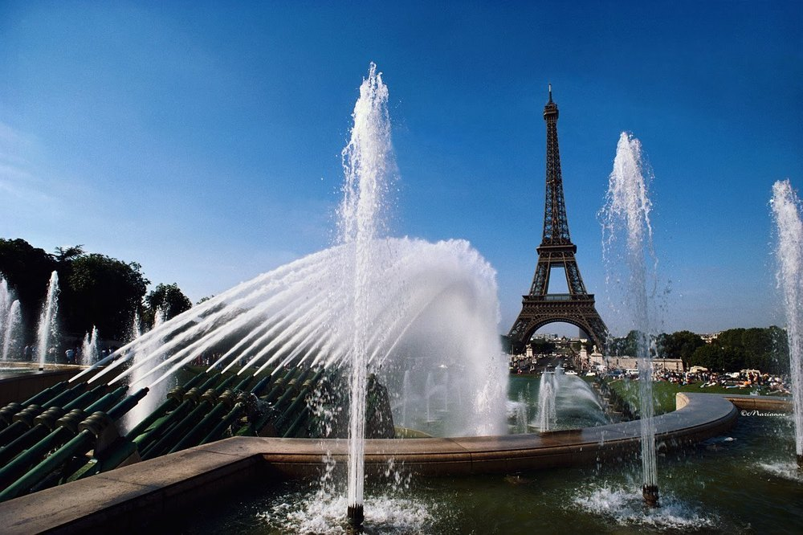

Slide 8




Slide 9


Slide 10


Slide 11

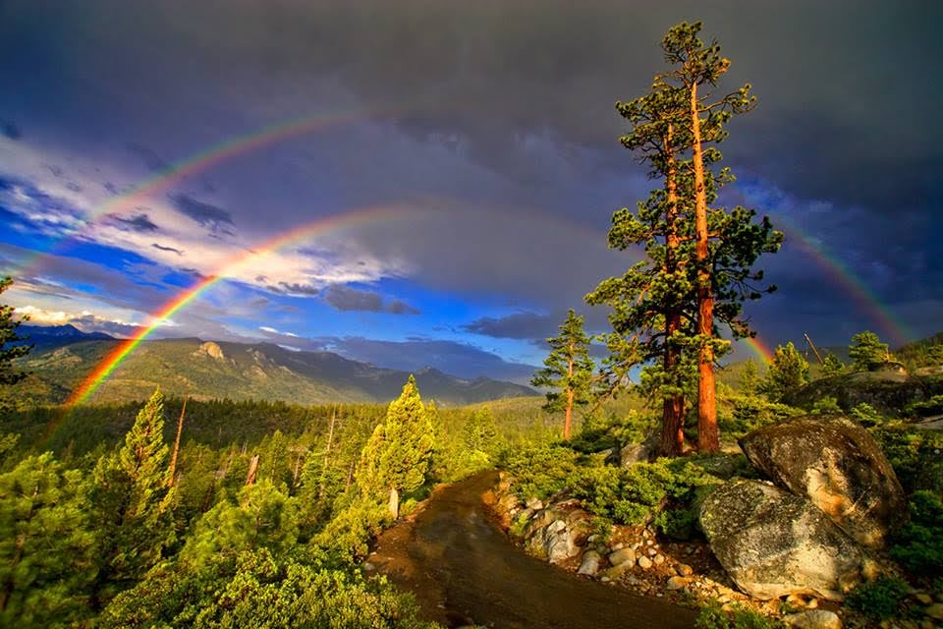

Slide 12


Slide 13



Slide 14
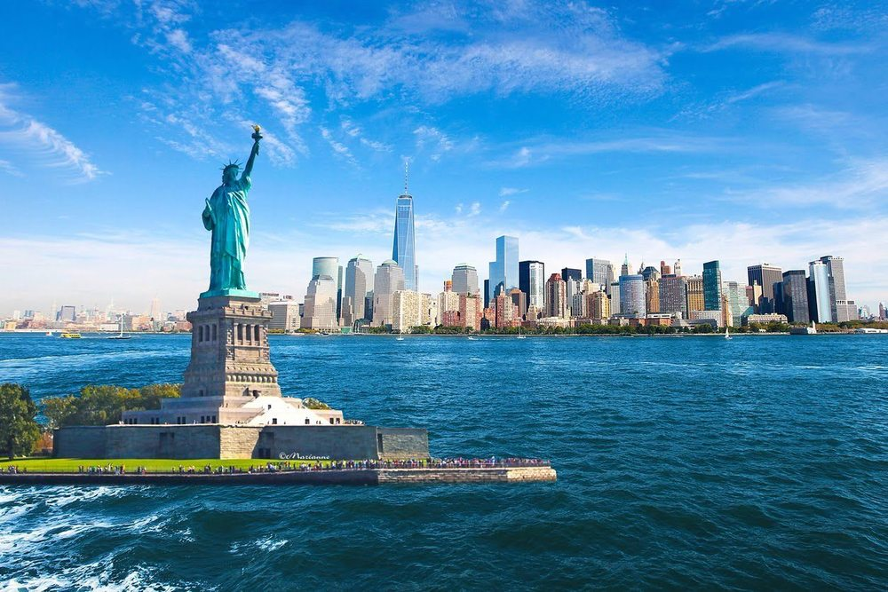


Slide 15
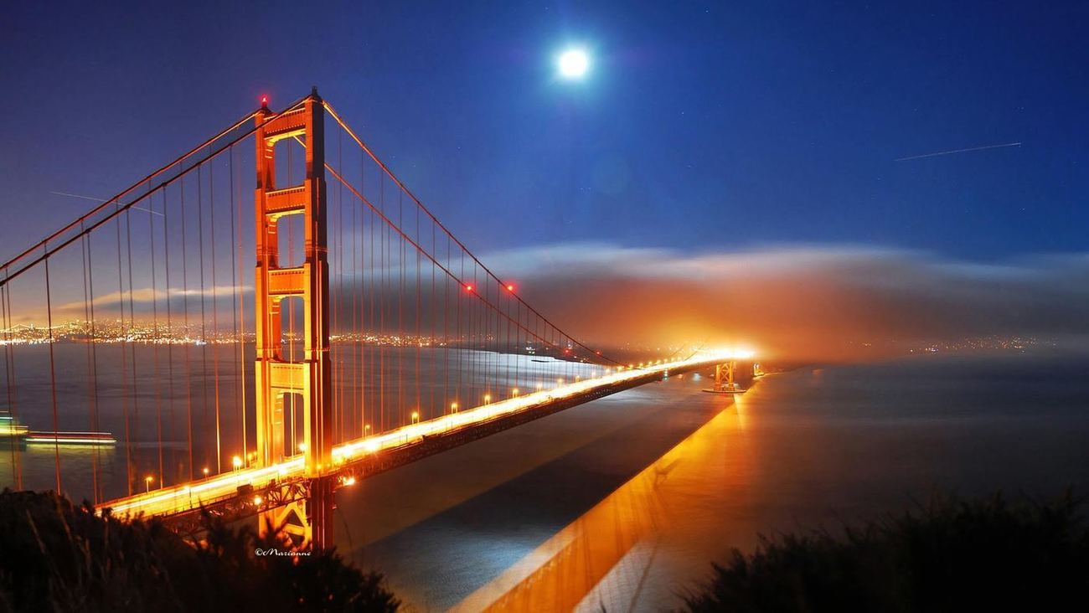

Slide 16



Slide 17


Slide 18



Slide 19



Slide 20


Slide 21



Slide 22




Wonderful Life
Zucchero
EXIT
Powerpoint_Marianne
Click Here
Marianne

